Slide 1



X
Digital User Churn
Dahsboard
Business Intelligence Analyst
Virtual Internship Program
Presented by
Muhammad Cikal Merdeka

Slide 2

Created by:
Muhammad Cikal Merdeka
Email : mcikalmerdeka@gmail.com
LinkedIn : linkedin.com/in/mcikalmerdeka
Github : github.com/mcikalmerdeka
Experience
Research Assistant
Institut Teknologi Bandung
January 2021 – April 2023
Laboratory Assistant
Institut Teknologi Bandung
August 2020 – May 2021
Dedicated entry-level data scientist with analytical and experimental background of Physics. My graduation 2023, a pivotal year marked by significant advancements in artificial intelligence with the introduction of GPT-4 and other generative AI models, has fueled my curiosity and excitement to delve into the field of data. I have comprehensive grasp of data science methodology from business understanding to modelling process with proficiency in Python, SQL, Tableau, Power BI, Looker Studio and other tools related to data analytics workflow from several coursework and bootcamps.
Education
Institut Teknologi Bandung
Bachelor of Physics
August 2018 – January 2023
Rakamin Academy
Data Science ML Specialization Bootcamp
October 2023 – March 2024

Slide 3


Case Study
A company has requested us to analyze the sales results of its products over several previous periods. Based on the data tables provided by the company, including Customers, Products, Orders, and ProductCategory, we will perform visualizations aimed at determining:
1. Total overall sales
2. Total overall sales by product category
3. Total overall quantity by product category
4. Total sales by city
5. Total quantity by city
6. Top 5 product categories with the highest sales
7. Top 5 product categories with the highest quantity
Then, from the insights obtained from these visualizations, we will derive a business insight and formulate business recommendations that can maintain or increase sales.

Slide 4
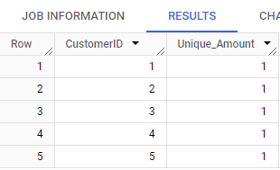
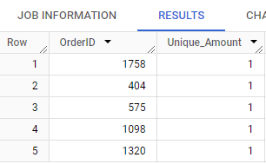

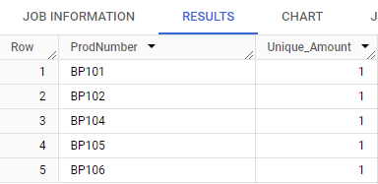
Task 1 : Determining Primary Key for Each Table
The selection of a primary key for a table is based on the unique nature of its values for each row of data:
Primary key for the Customers table: CustomerID
Primary key for the Orders table: OrderID
Primary key for the Products table: ProdNumber
Primary key for the ProductCategory table: CategoryID
This is further reinforced by examining each column using a query with its aggregate count.
Customers PK
Orders PK
Products PK
ProductCategory PK

Slide 5
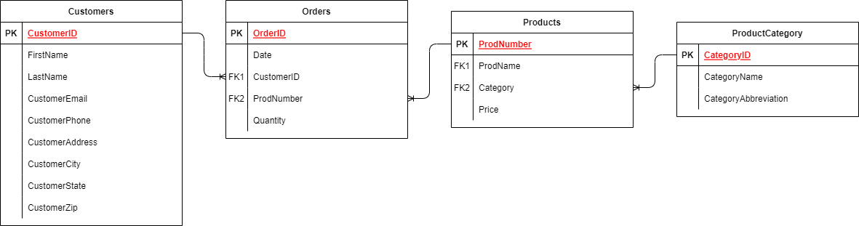
Task 2 : Designing Entity Relation Diagram (ERD)
After determining the primary keys for each table, we can formulate relationships between tables by utilizing Foreign Keys in other tables. Below is the ERD of the four tables.
The relationships between the tables are as follows:
The Customers table has a one-to-many relationship with the Orders table.
The Orders table has a many-to-one relationship with the Products table.
The Products table has a many-to-one relationship with the ProductCategory table.

Slide 6
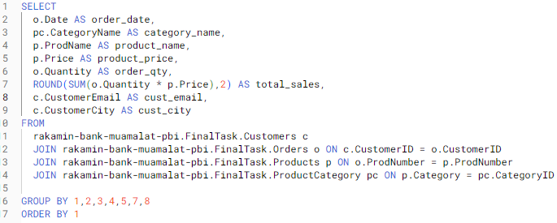
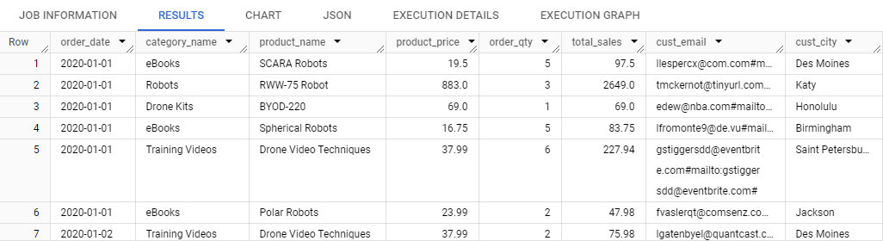
Task 3 : Master Table Formulation
Before conducting the analysis in the form of a dashboard in Looker Studio, we need to merge the four tables by selecting columns that contain relevant information about what we will analyze, as explained earlier. Here is the query and the result of the master table.
SQL Query
Query Table
The master table is then exported into CSV format to be used as a data source in Looker Studio.

Slide 7
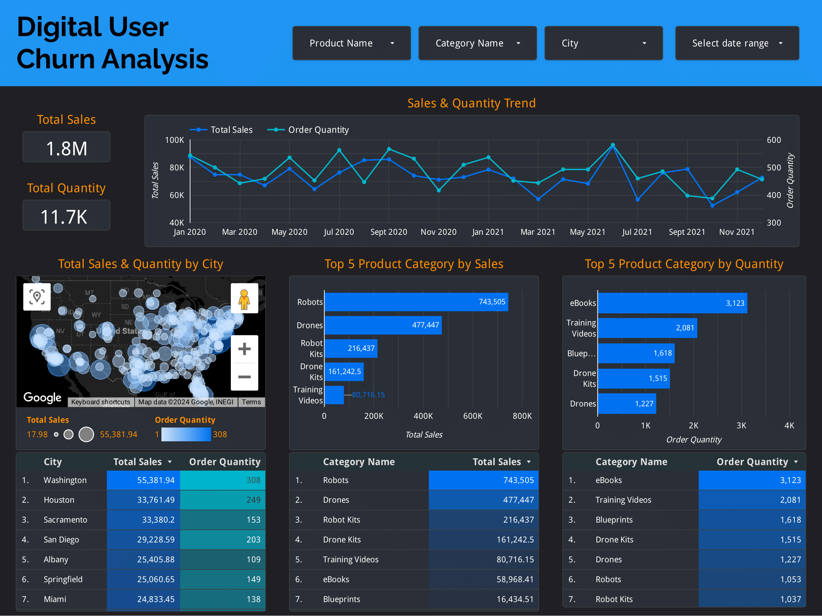
Task 4 : Dashboard Creation
Looker Studio dashboard can be accessed
through this Link.
Main Takeaways :
Total overall sales amount to $1,754,750.57, with a total quantity of products sold amounting to 11,654 units.
The categories Robots, Drones, Robot Kits, Drone kits, and Training Videos are the top-selling product categories. On the other hand, in terms of order quantity, the categories eBooks, Training Videos, Blueprints, Drone Kits, and Drones are the most frequently purchased.
The city of Washington emerges as the primary hub of transaction activities, with the highest sales and order quantity.
Based on the sales and order quantity trends, the business has not been in a stable condition since early 2020, especially in 2021, where there have been significant fluctuations in sales every month.

Slide 8
Task 5 : Business Recommendation
Based on the insights that we gather from our dashboard, we can formulate several recommendations which could increase the performance of company business:
Focus on Top-Selling Product Categories
Allocate more resources and marketing efforts towards the top-selling product categories such as Robots, Drones, Robot Kits, Drone kits, and Training Videos. These categories have shown consistent demand and can be leveraged to drive higher sales.
Target Marketing Campaigns
Given that Washington is the primary hub of transaction activities, tailor marketing campaigns and promotions specifically targeting customers in this region. Utilize local advertising channels and partnerships to increase brand visibility and attract more customers.
Enhance Customer Retention Efforts
Focus on retaining existing customers by providing personalized experiences, offering loyalty programs, and implementing targeted retention campaigns. Analyze customer churn patterns to identify at-risk customers and proactively address their concerns to prevent churn.
Optimize Inventory Management
Since eBooks, Training Videos, Blueprints, Drone Kits, and Drones are the most frequently purchased products in terms of order quantity, ensure adequate inventory levels for these items to meet customer demand and prevent stockouts. Implement inventory forecasting techniques to optimize stock levels and reduce carrying costs.

Slide 9
Github Project Link
https://github.com/mcikalmerdeka/Business-Intelligence-Analyst-Bank-Muamalat---Rakamin-PBI-Program

Slide 10




Thank You
X

